Slide 1

Cyclistic: a bike usage analysis

Slide 2
Objective
To analyse and gain an understanding of how annual members and casual riders use Cyclistic bikes differently to determine the best marketing strategy to convert casual riders into annual members

Slide 3
Data Preparation
The data was downloaded from Cyclistic data site in csv file format and ingested into SQL Sever Management Studio alongside Tableau to create data visualisations.
It is assumed the data is credible as it was compiled and published by the Cyclistic organisation
Period covered was from January 2021 through to December 2021
Data anomalies were cleaned where possible, however, a number of queries have arisen which will need to be discussed with Cyclistic to support more effective analysis, these are noted in the appendix

Slide 4
Exclusions and Additions
Data that was excluded from the analysis includes:
Rides where the start station or end station location were null
Rides where the start date was after the end date
Ride lengths that were less than or equal to 0 minutes
In addition to the excluded data, some new columns were added/some columns were edited to aid analysis, these were:
Ride length
Weekday of the start of the ride
Weekday of the end of the ride
Month when the ride started
Datatype of started_at, ended_at, start_lat, start_lng, end_lat and end_lng were updated as they were not consistent between tables

Slide 5
Exclusions and Additions
Data that was excluded from the analysis includes:
Rides where the start station or end station location were null
Rides where the start date was after the end date
Ride lengths that were less than or equal to 0 minutes
In addition to the excluded data, some new columns were added/some columns were edited to aid analysis, these were:
Ride length
Weekday of the start of the ride
Weekday of the end of the ride
Month when the ride started
Datatype of started_at, ended_at, start_lat, start_lng, end_lat and end_lng were updated as they were not consistent between tables

Slide 6
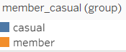
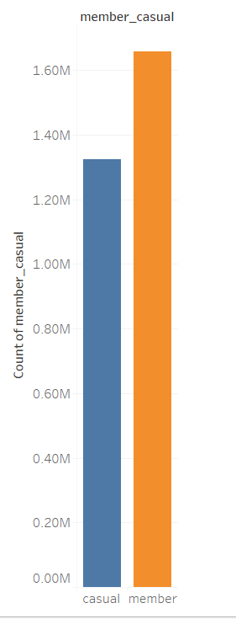
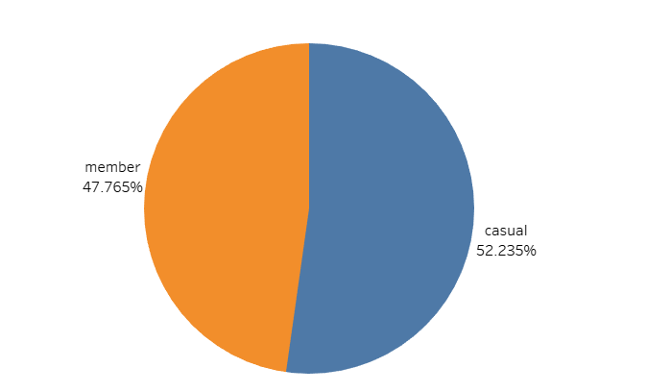
Number of rides by rider type
Annual members exceeded the number of casual riders in 2021

Slide 7
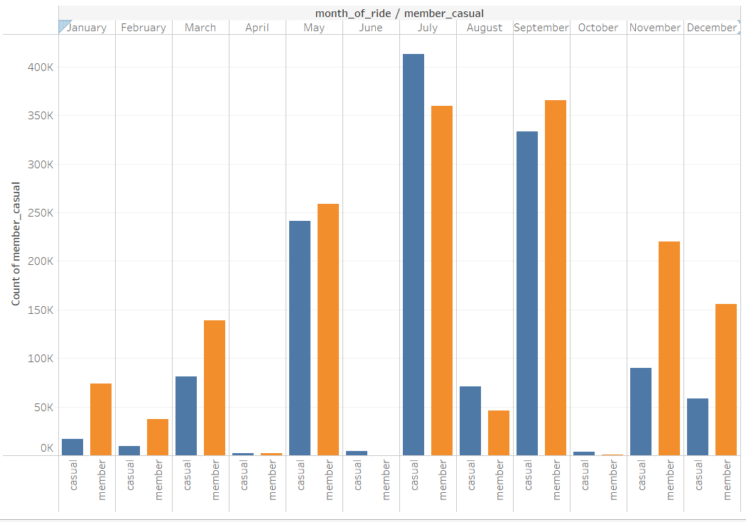
Number of trips by month and rider type
Generally the number of annual member riders exceeded the number of casual riders
This is with the exception of the following months where casual riders exceed annual members:
June
July
August
October
It would appear that during summer months larger numbers of casual riders use Cyclistic
Further research will need to be conducted to understand if these trends match across different years

Slide 8
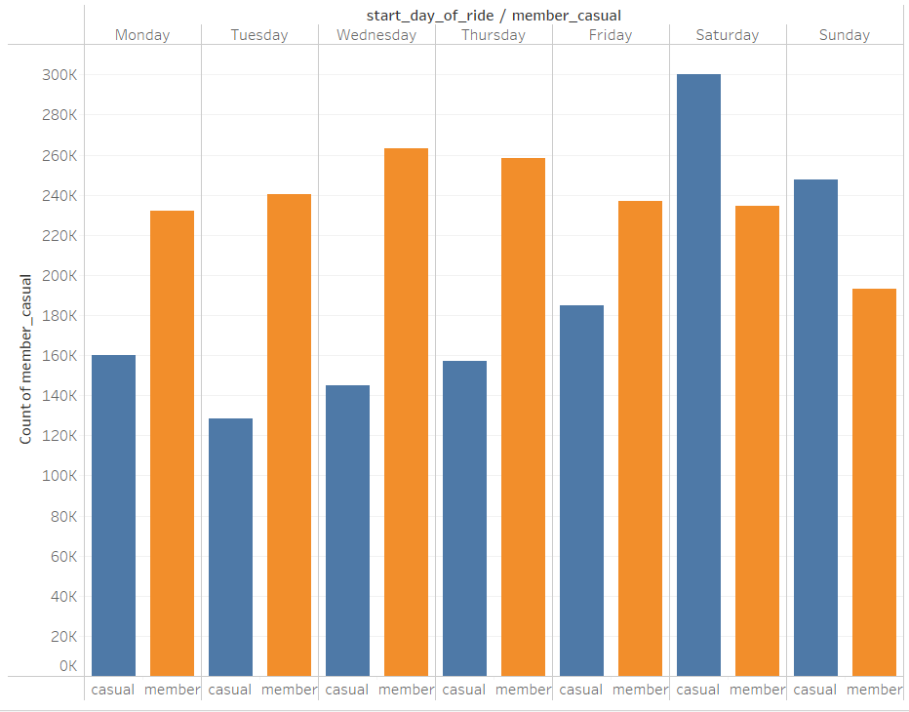
Number of trips by weekday and rider type
Generally the number of annual member riders exceeded the number of casual riders
This is with the exception of the following days where casual riders exceed annual members:
Saturday
Sunday
It would appear that during the weekend more casual members avail of Cyclistic services
Trips across the week are relatively consistent for Cyclistic members, particularly for the working week (M-F) indicating that a number of Cyclistic annual members may use Cyclistic services to travel to work.
Further research will need to be conducted to understand if these trends match across different years and research should be done to understand how cyclistic members use cyclistic e.g. for leisure, work or exercise etc.

Slide 9
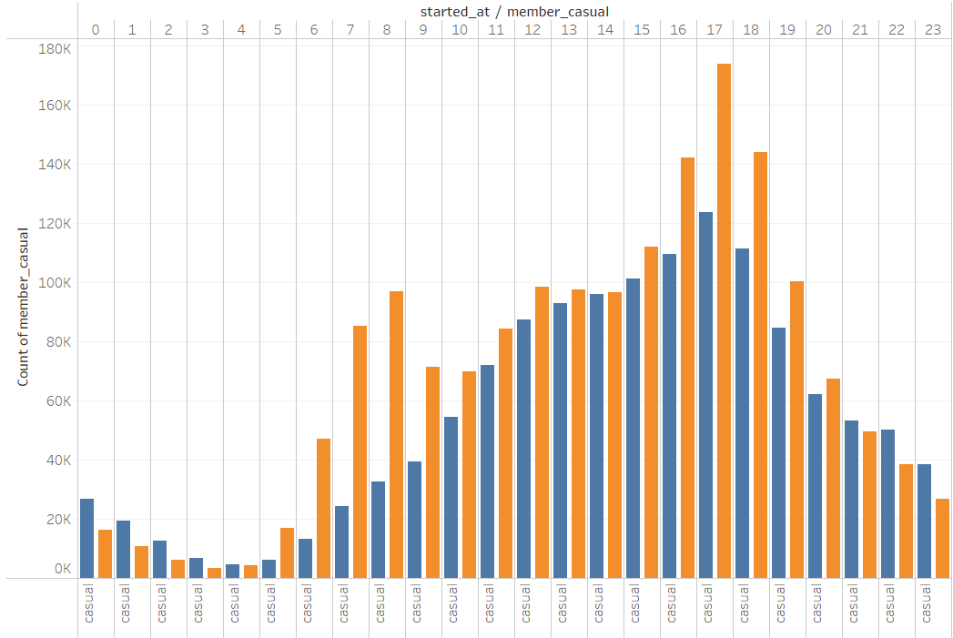
Number of trips by time of day and rider type
Tying in with the previous analysis it would appear that annual members use cyclistic services more between the hours of 6am and 9am and between 4pm and 7pm. Inferring that cyclistic services are mainly used for annual member’s work commutes.
Casual users tend to exceed annual member usage during the later hours of the day e.g. 9pm-midnight and the earlier hours of the morning e.g. 1 am-4am indicating that some casual riders utilise cyclistic services for leisure/exercise. Casual riders tend to also have high bike usage during the afternoon
Number of trips during the day peaks at 5pm

Slide 10
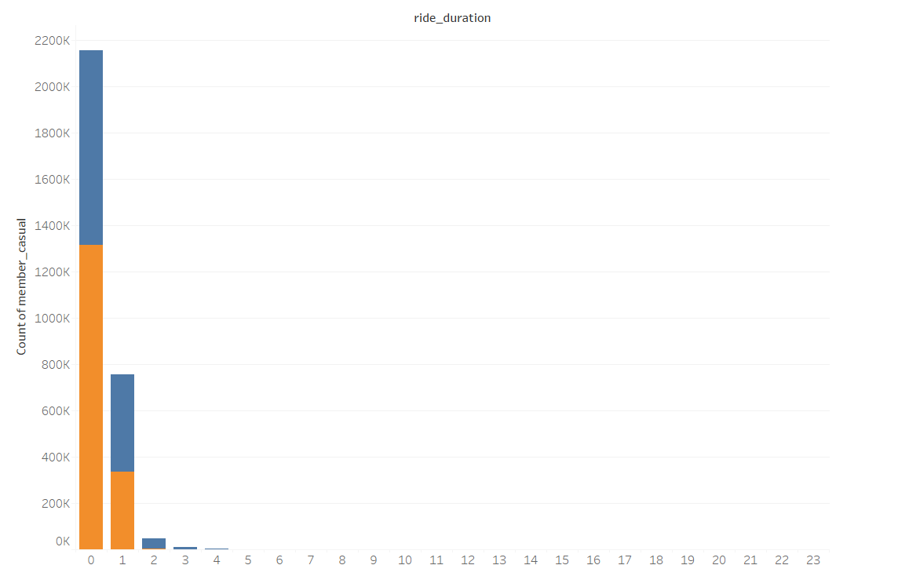
Trips by duration and rider type
Trips under 24 hours in length
Both cyclistic annual members and casual riders appear to use Cyclistic bikes for under an hour, or up to two hours.

Slide 11
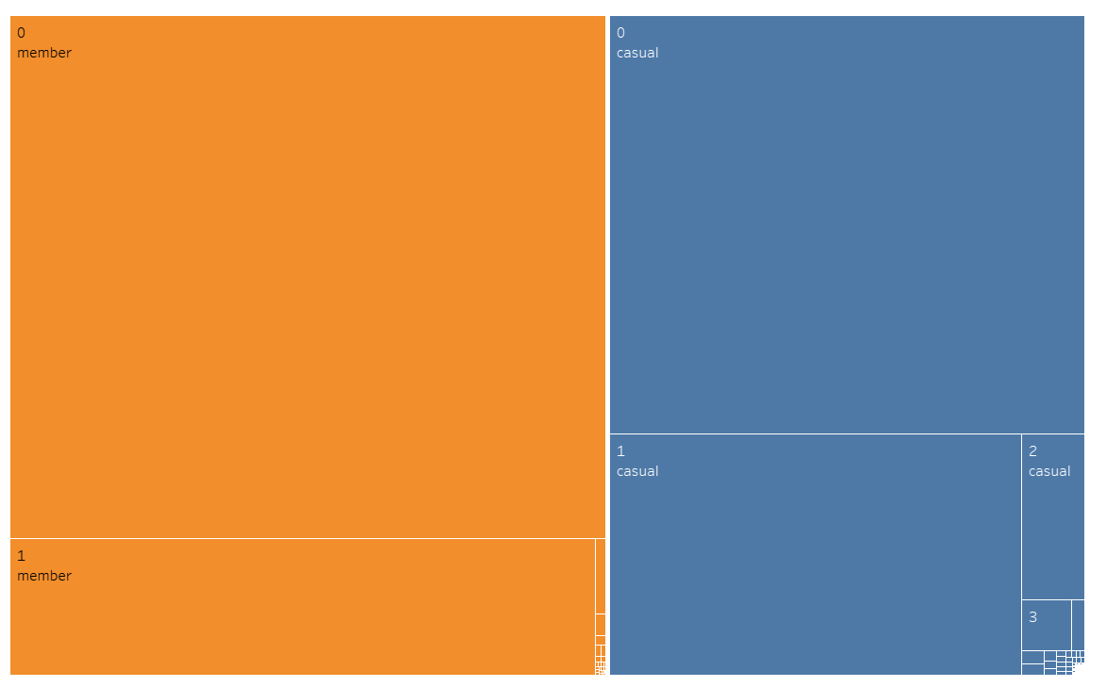
Trips by duration and rider type
Further analysis indicates that while annual members and casual riders tend to utilise cyclistic cycles for up to 2 hours, casual riders use cyclistic cycles for a much longer duration

Slide 12
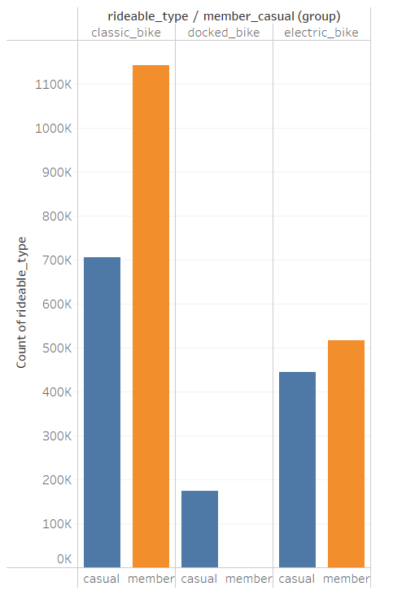
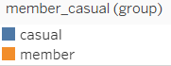
Bike Type Usage by rider type
Annual members tend to favour classic and electric bikes and casual riders tend to do the same, however, casual riders have a much larger uptake on docked bikes
Overall docked bikes appear to be least preferred by both rider types

Slide 13
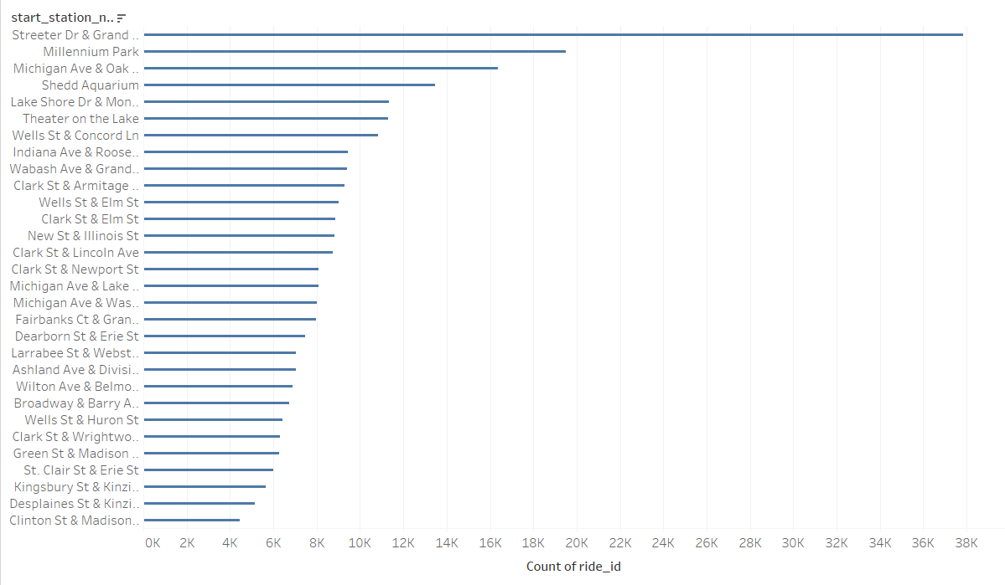
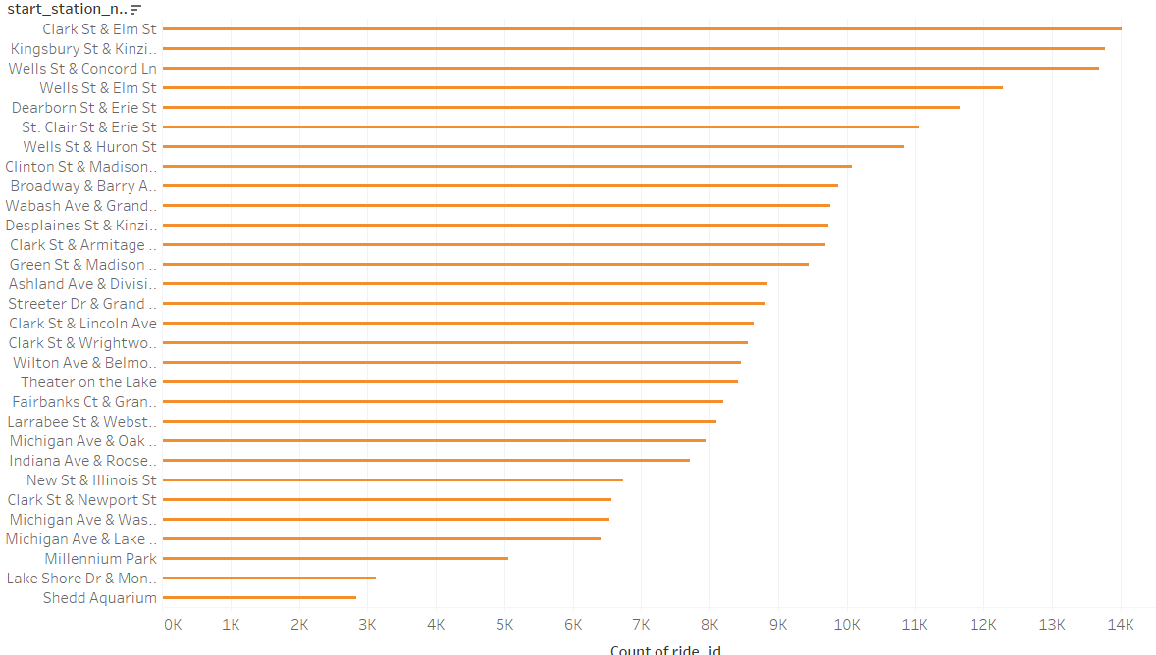
Most popular trips by location
Casual riders appear to mainly pick up their bikes in central chicago whereas annual members appear to start their rides in North Chicago in more suburban areas
Top start locations-Casual rider
Top start locations-Annual member rider

Slide 14
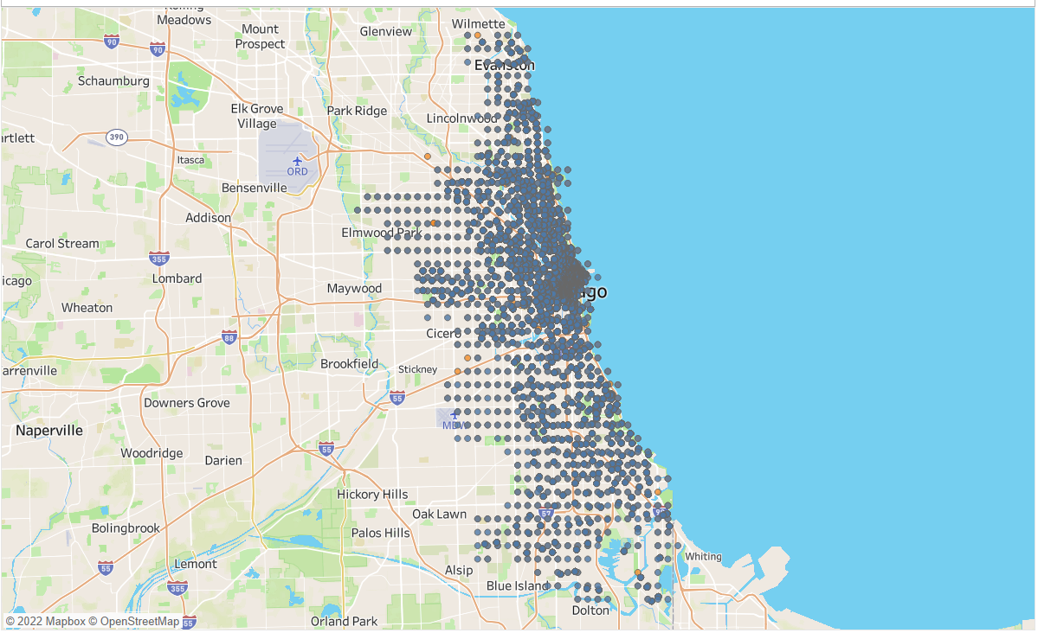
Geographical spread of Cyclistic Users Part 1
Most of Cyclistic bike rides are made in central and North Chicago

Slide 15
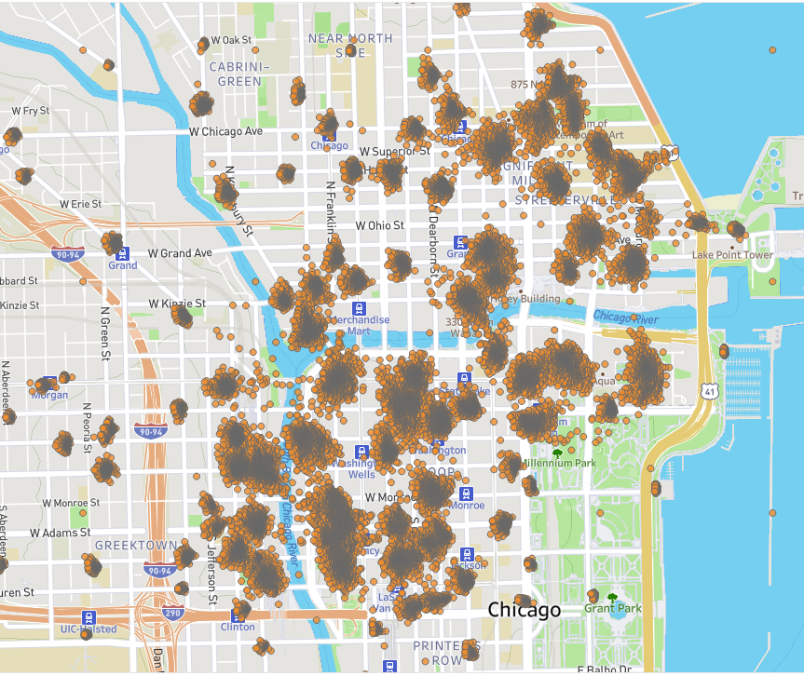
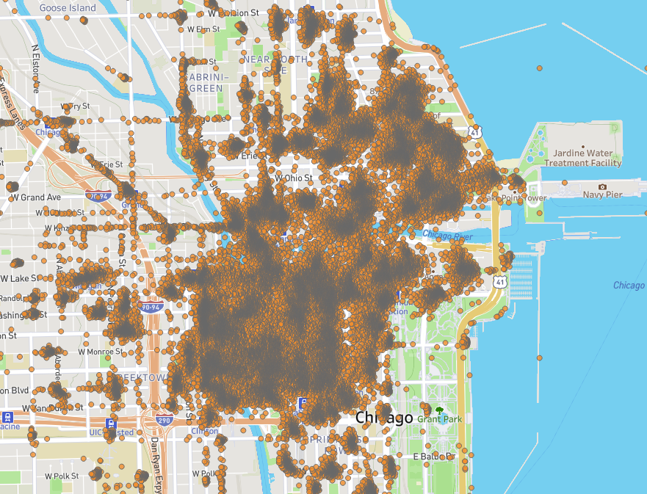
Geographical spread of Cyclistic Users part 2
A significant number of annual members appear to start rides in central Chicago
It should be noted that a significantly larger number of annual members end their rides in central Chicago, indicating a trend that Cyclistic annual members ride bikes from outer Chicago into the city centre

Slide 16
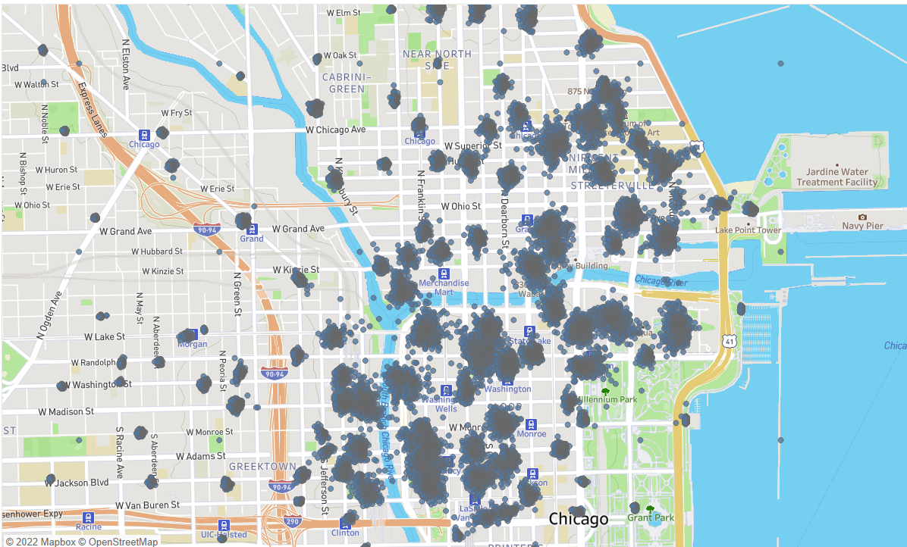
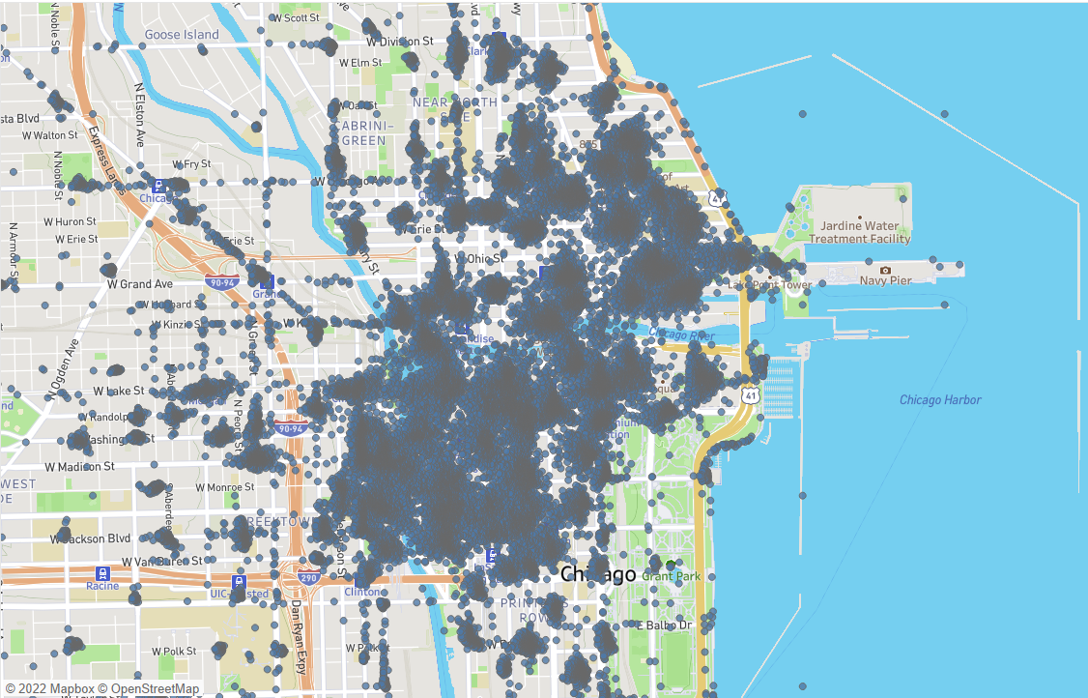
Geographical spread of Cyclistic Users part 3
The majority of casual riders appear to start their rides in and around central chicago
It should be noted that a significantly larger number of casual riders end their rides in central Chicago, indicating a trend that Cyclistic casual riders start their ride from outer Chicago into the city centre

Slide 17
Overall Takeaways
The majority of casual riders tend to focus their Cyclistic ride journeys in and around central Chicago
Casual riders tend to have a ride duration of up to two hours and tend to prefer classic and electric bikes, however, also have a significant update of docked bikes compared to annual members who don’t use docked bikes as much
Casual riders mainly appear to bike during the weekend and during summer months
Casual riders appear to use bikes for longer of periods of time, however, the majority of users (casual or annual member) use bikes for up to two hours.

Slide 18
Recommendations
Launch targeted campaign to casual members offering discount for weekend rides if they sign up as annual members
Increase number of docked stations
Increase number of bikes available during summer months and potentially offer promotions on annual membership during run up to summer months e.g. April/May to convert casual riders
Conduct further research and analysis as noted in next steps

Slide 19
Next steps
Conduct further research
User based research to understand why casual riders use the bikes
Conduct further analysis across time to show change in trends over years
Look to understand how data changed from pre-pandemic to pandemic as data covered looks at activity during the pandemic. Has usage dropped/increased due to the pandemic? Are members less likely to use docked bikes due to fear of transmission?
Add rider id/name to rides to analyse frequency of rides between annual members and casual riders
Clarify queries noted in the appendix

Slide 20
Assumptions for Data processing
Due to some issues with the data supplied, some data was excluded from processing and analysis to avoid skewing results. The data excluded includes:
Rides where the start station or end station location were null
Rides where the start date was after the end date
Ride lengths that were less than or equal to 0 minutes

Slide 21
Queries
Why are the naming of station ids not consistent some are numeric, some are alpha numeric?
Should we include rides that are length of 0 min or less?
Should we include rides that have no end location?
Why are ride_ids not unique?
Should we just focus on rides that took place using a docked_bike?
When we refer to stations, are they docking stations or stations where bikes can be collected e.g. including electric/classic bikes?
We have conducted an analysis of data from January 2021 through to December 2021, and, therefore have included rides which started in December 2021 but ended in January 2022, should these be excluded from future analysis?
What is the battery life of electric bikes, is this inhibiting longer journey times by some users?
Are some users put off by electric bikes due to lack of awareness of battery life

